Slide 1
Modelling a Cold Atom using a Driven Gyroscope
Project by Edward Taylor and Charlotte Dodd
22/02/2018

Slide 2
Aims
Drive a gyroscope using a motor
Produce a torque with electromagnetism causing the gyroscope to process
Measure the angular velocity of the rotation and procession
Analyse the accuracy of the gyroscope as a model for the cold atom with the Bloch sphere model.

Slide 3
Theory
Bloch sphere
Biot-Savart
Helmholtz coil

Slide 4
Feasibility studies
Driving the rotor of the gyroscope with a current
With small conducting magnets
Tachometer and motor arrangement

Slide 5
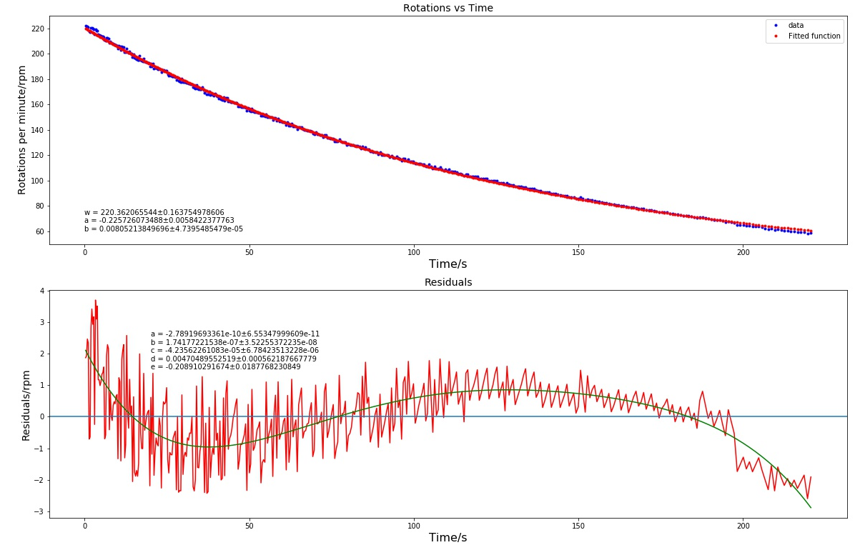
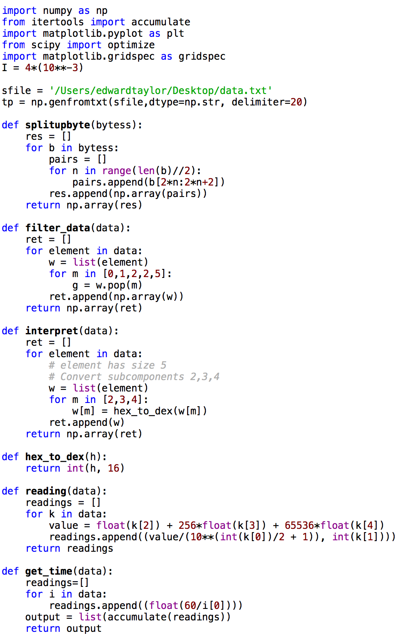
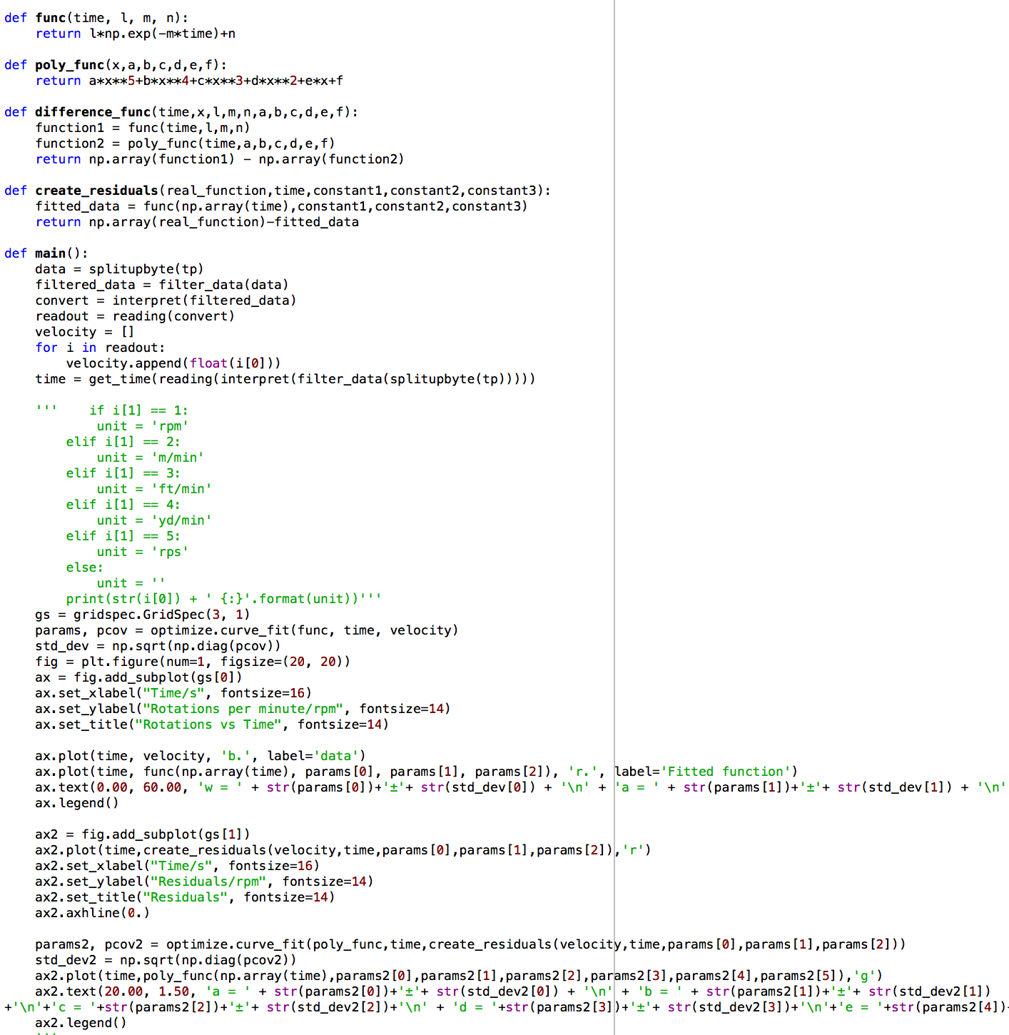

Programming

Slide 6
Data manipulation
Data input: 0D020001014DA6560000
Put data in pairs: ['0D', '02', '00', '01', '01', ’4D', 'A6', ’56’, ’00’, '00']
Keep pairs needed: ['02' '01' 'A6' '56' '00']
Converted to decimal (from hex): [02, 01, 166, 86, 0]
Find rpm (without unit): float(k[2]) + 256*float (k[3]) + 65536*float(k[4]) = 221.82
Create rpm + decimal place: readings.append((value/(10**(int(k[0])/2 +1),int(k[1])))
Get rpm with unit: [(221.82, 1),…] → 221.82 rpm

Slide 7
Graphing the data
Finding time when reading taken: [(221.82, 1),…]
Loop over pairs creating list of times cumulatively adding previous time of measurement
readings.append((float(60/k[0]))) → returns a time → list(accumulate(readings) → summing them up
E.g readings.append(float(60/221.82)) → [0.27, a, b, c] → [0.27, 0.27+a, 0.27+a+b, 0.27+a+b+c, …]
Use an arbitrary fit function: params, pcov = optimize.curve_fit(func, time, velocity)
Plot velocity vs time
Extract fit parameters: standard_deviation = np.sqrt(np.diag(pcov))

Slide 8
Plans
Currently in workshop having motor fitted
Code being written to interpret results from the tachometer
Magnet analysis and attachment
Weeks 9-10 is testing
Finishing and report writing

Slide 9
So far
Research and design of Faraday Disk
Redesign and proposal
Motor design

Slide 10
Summary

Slide 11
Bibliography

